Slide 1
Sustainability in Human Relationships
Both schools are very accepting and supportive of its student and we are thankfull to go to these schools.
Budapest & Ljubljana

Slide 2
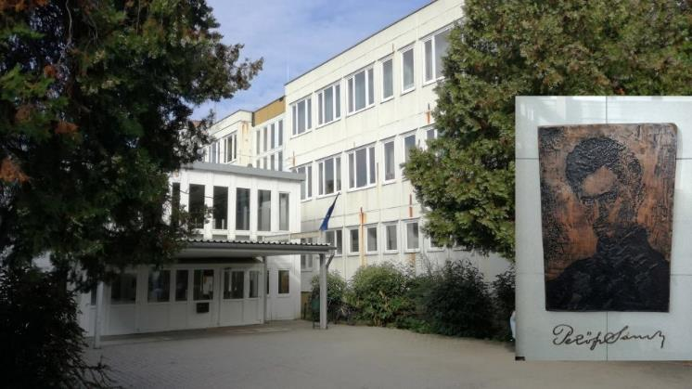
Budapest (Újbudai Petőfi Sándor Általános Iskola)
In our school, we have development tutoring, and prep class for learning disabilities , and students who need help with further education.
We also have a school psychologist.
Social workers sometimes come to our school , and give a presentation / talk about internet safety, mental health, etc.

Slide 3
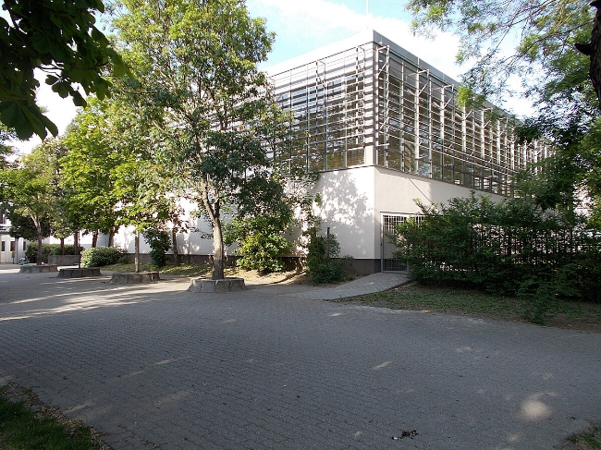
Budapest (Újbudai Petőfi Sándor Általános Iskola
Our school library has books in almost every theme for example : study books, kid books, cooking books etc…
We have headteachers’ class aswell here we talk about the class and also the student council news.

Slide 4
Ljubljana (Osnovna šola Hinko Smrekarja)
In Slovenia, we help immigrant students overcome the language barrier, by giving them extra slovanian language classes.
We also have social workers, that take students out of class to help them with the material that they’re studying in that class.
There’re also social workers who help students with mental health.

Slide 5
Ljubljana (Osnovna Sola Hinko Smrekarja)
Theres also a charity work that our school does, when stuedents have to bring some euros or a little food for people in need.
The library at our school has books in many different languages so everyone feels included.
We also have a headteachers class at the end of the week.

Slide 6
SIMILARITIES
We both have headteachers class.
Tutoring for students in need.
School phychologists.
Charity for people in need.
Both schools promote equality in different ways, and it’s very important to include everyone, no matter nationality or race.

Slide 7
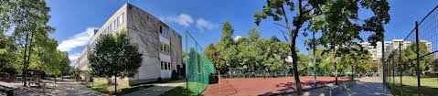
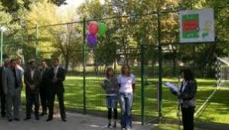
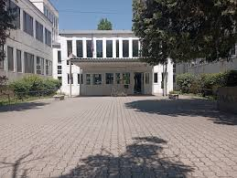
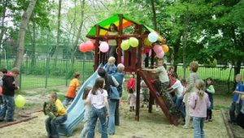
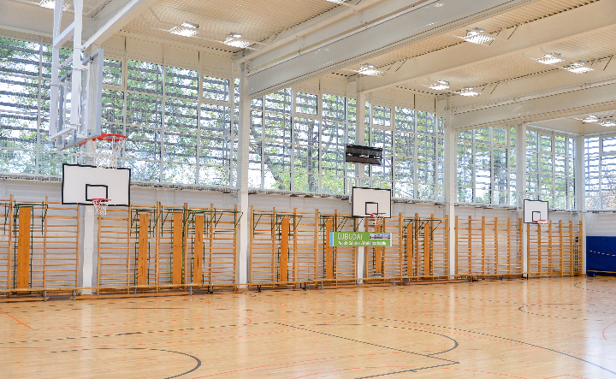
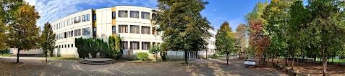

Slide 8
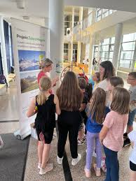
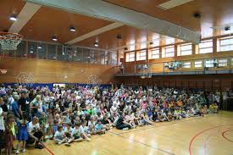
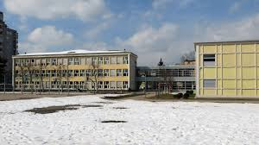
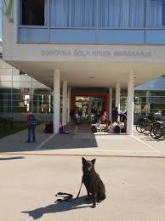
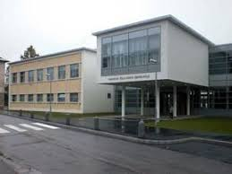
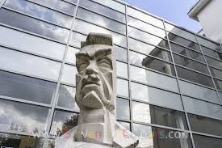

Slide 9
Thank you for your attention
Szabó Hanna Hilda, Számedly Hanna, Nagy Nóra, Kornhoffer Zita,
Elina Oksuzyan, Elena Martynova

