Slide 1

Sustainability in the two schools
Made by: Magyarosi Dorka, Hadnagy Hanna, Sági Rita,Dora Brkljac, Doroteja Lena Stular, Neza Marincic

Slide 2
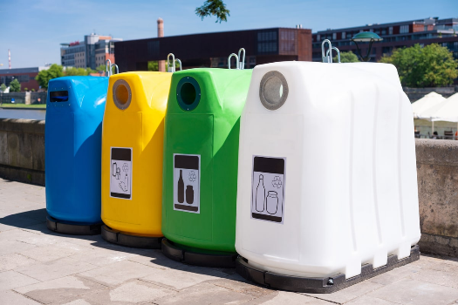
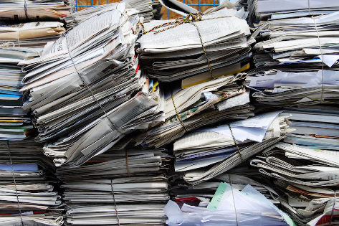
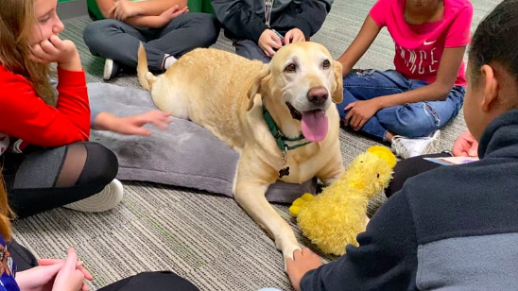
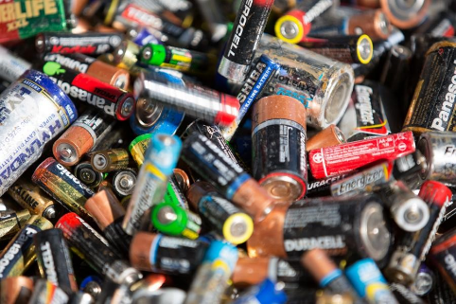
Similarities in both schools
Selective trash collecting
Collecting paper
Dog school visiting
Collecting batteries

Slide 3
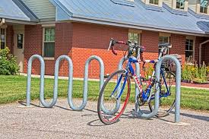
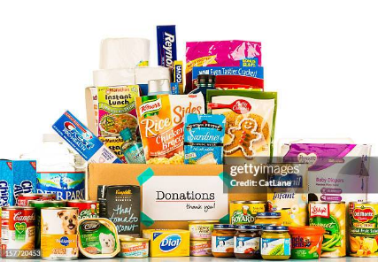
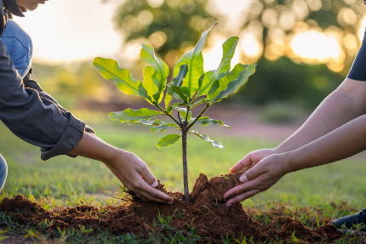
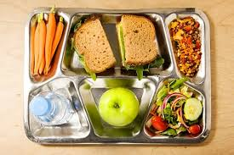
Similarities in both schools
Bicycle storage
Pet food collecting
Planting trees
Healthy food

Slide 4
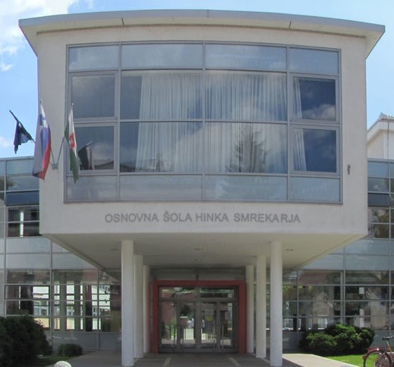
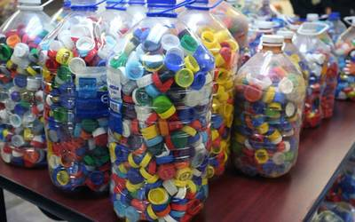

Sustainability in both schools
differences
OŠ HINKA SMREKARJA
Collecting caps from bottles
Wearing slippers

Slide 5
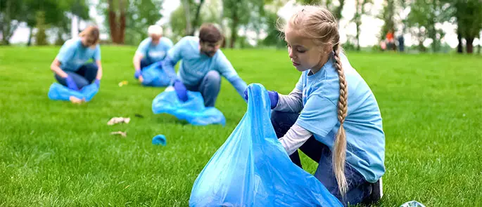
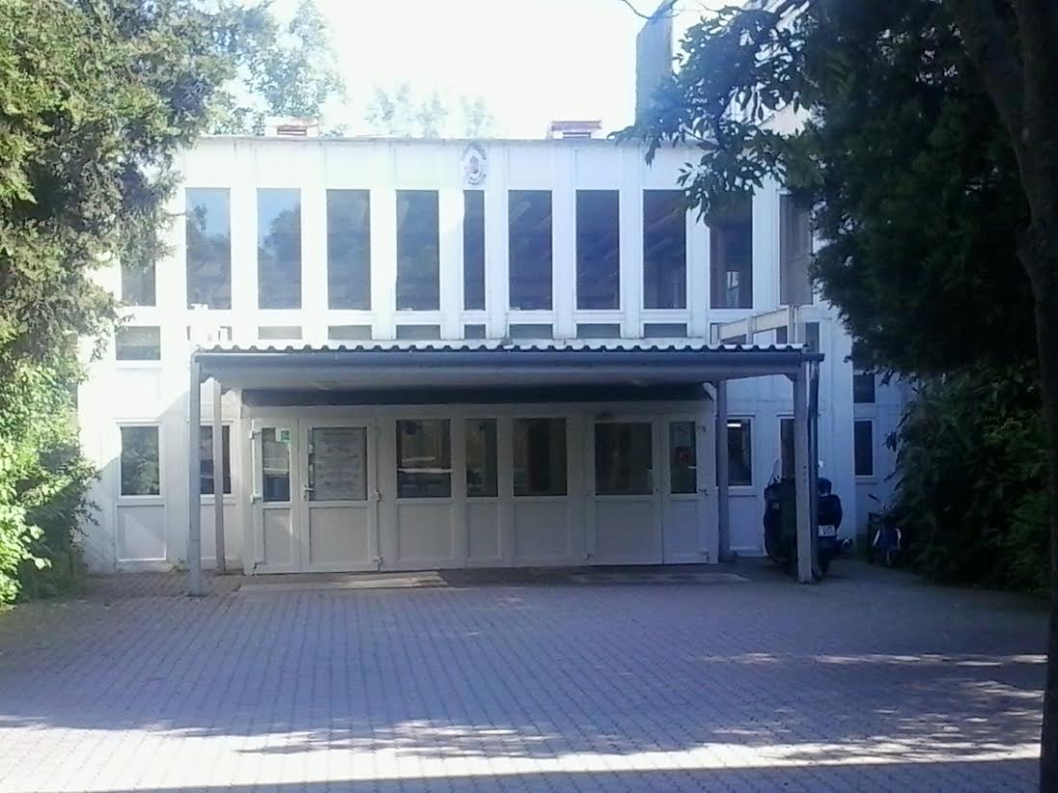
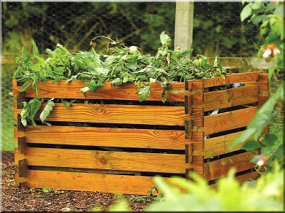
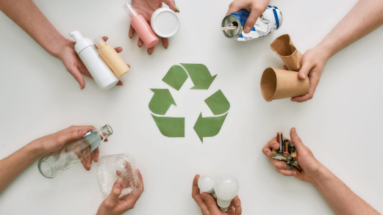
Sustainability in both schools
differences
ÚJBUDAI PETŐI SÁNDOR
ÁLTALÁNOS ISKOLA
Composting
Zero waste posts
Collecting trash outside school

Slide 6
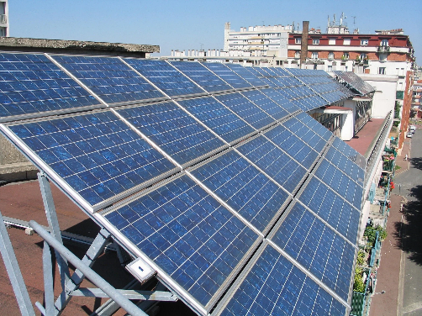

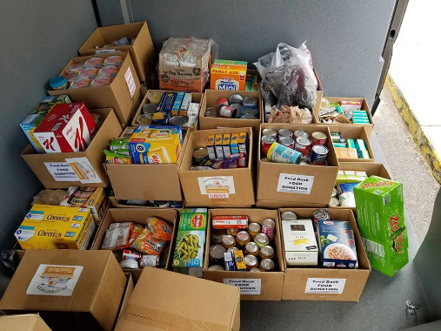
Ideas
Solar panels
More digital assignments
Donating leftover food if possible
Green competitions: “Which class can reduce the most waste?”

Slide 7

Why is sustainability important?
Sustainability is crucial because
Environmental Preservation
Future Generations
Economic Stability
Social Well-being & Equity
Health Improvement
Climate Change Mitigation

Slide 8

Thank you for your attention!
Magyarosi Dorka, Sági Rita, Hadnagy Hanna, Doroteja Lena Štular, Neža Marinčič, Dora Brkljač
Sources: Google

